Slide 1
Adding Stationing in ArcGIS Lines
Sulochan Dhungel
5/28/2020

Slide 2
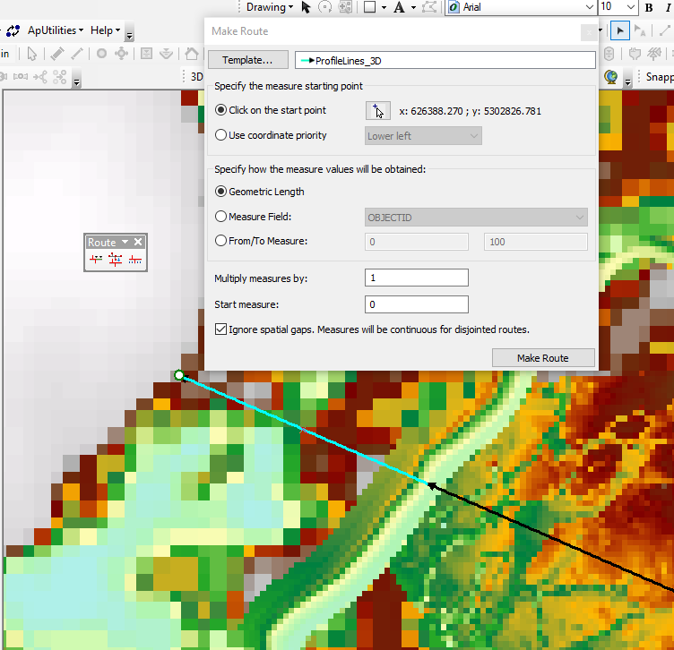
Activate “Routing Editing” toolbar
Convert lines to a feature class in a geodatabase.
Start Editing
Press Create Route
Select the line which you want to station
Change the start point based on where you want to start stationing

Slide 3
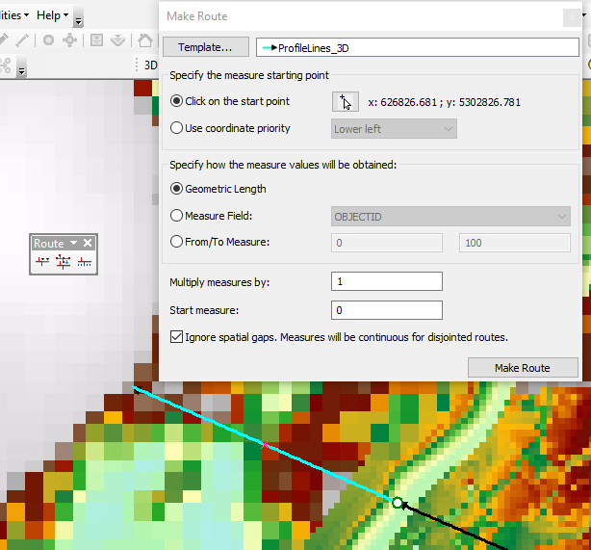
Activate “Routing Editing” toolbar
Convert lines to a feature class in a geodatabase.
Start Editing
Press Create Route
Select the line which you want to station
Change the start point based on where you want to start stationing
Click Make Route

Slide 4
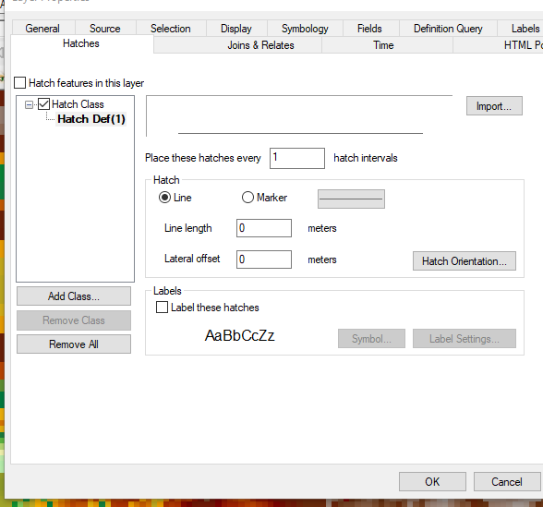

Slide 5
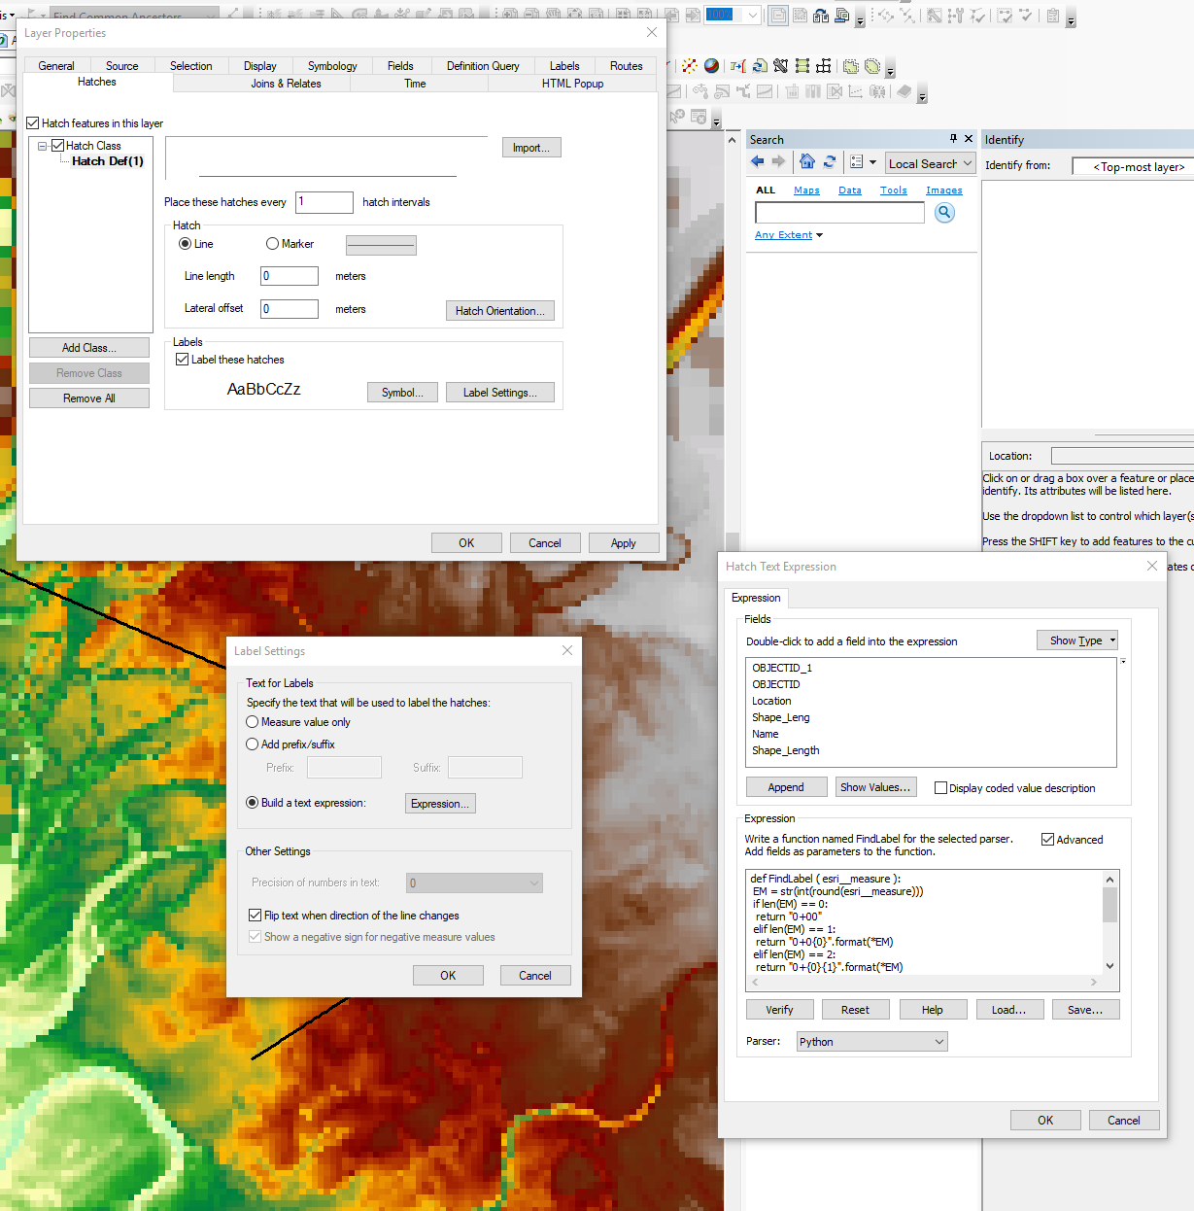

Slide 6
